Slide 1
5.3 Linear Independence

Slide 2
Linear Independence
Definition:
  If S = {v₁,v₂,...,v_{r}} is a non empty set of vectors then the vector equation k₁v₁+k₂v₂+....+k_{r} v_{r} = 0 has at least one solution, k₁=0, k₂=0, ..., k_{r}=0.
  If this is the only solution, then S is called a linearly independent set.
  If there are other solutions, then S is called a linearly dependent set.

Slide 3
Linear Independence
Example:
  v₁ = (2,-1,0,3), v₂=(1,2,5,-1), v₃=(7,-1,5,8) S={v₁, v₂, v₃} is linearly dependent since 3v₁+v₂ – v₃ =0.
  S = {p₁=1-x, p₂=5+3x-2x², p₃=1+3x-x²} is a linearly dependent since 3p₁-p₂+2p₃=0
  S={i, j, k}, where i=(1,0,0), j=(0,1,0), k=(0,0,1), is a linearly independent since 0i + 0j + 0k = 0;

Slide 4
Linear Independence
Theorem 5.3.1: A set S with two or more vectors is
  a) Linearly dependent iff at least one of the vectors in S is expressible as a linear combination of the other vectors in S
  b) Linearly independent iff no vectors in S is expressible as a linear combination of the other vector in S.
Example:
  V₁ = (2, -1, 0, 3), V₂ = (1, 2, 5, -1), V₃ = (7, -1, 5, 8)
  V₁ = -⅓ V₂ + ⅓ V₃, V₂ = -3V₁+V₃, V₃ = -3V₁+V₂

Slide 5
Linear Independence
Theorem:
a) A finite set of vectors that contain the zero vectors is linearly dependent
b) A set with exactly two vectors is linearly independent iff neither vector is a scalar multiple of the other.

Slide 6
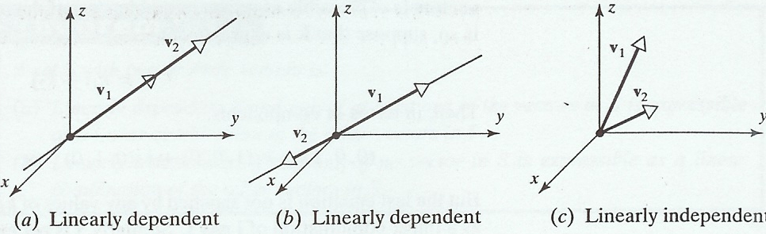
Geometric Interpretation of Linear Independence
In R² or R³, a set of two vectors is linearly independent iff the vectors do not lie on the same line when they are placed with their initial points at the origin.

Slide 7
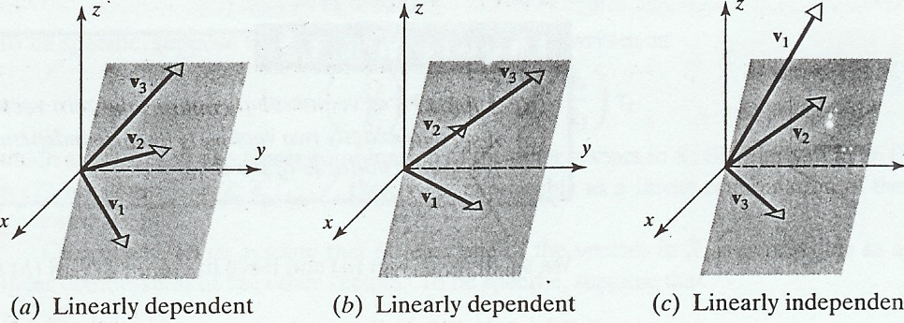
Geometric Interpretation of Linear Independence
In R³, a set of three vectors is linearly independent iff the vectors do not lie in the same plane when they placed with their initial points at the origin.

Slide 8
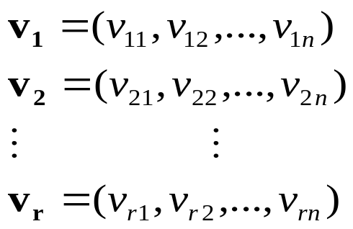

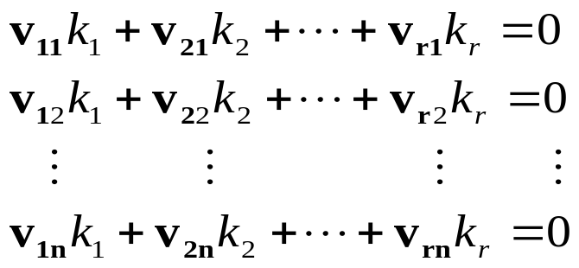
Geometric Interpretation of Linear Independence
Theorem 5.3.3: Let S={v₁,v₂,...,v_{r}} be a set vectors in R^{n}. If r>n, then S is linearly dependent.
Proof:
homoggeneous system of n
equations in the r unknowns
k₁,...,k_{r}. Since r>n, the system has
nontrivial solutions. Therefore, S is
a linearly dependent set.

Slide 9
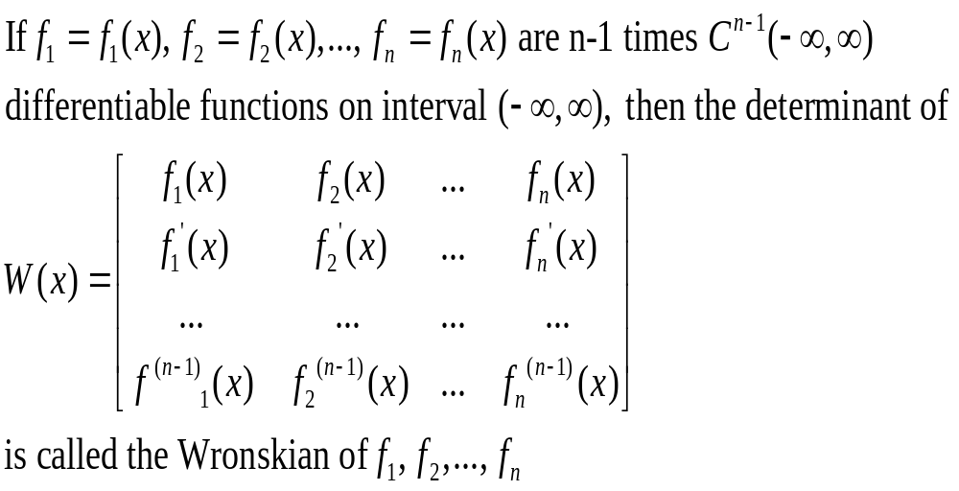
Linear Independence of Functions

Slide 10
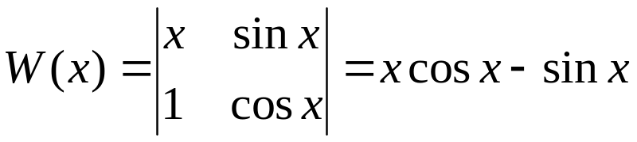
Linear Independence of Functions
Theorem: If the functions f₁, f₂,..., f_{n} have n-1 continuous derivatives on the interval (-~,~), and if the Wronskian of these functions is not identically zero on (-~,~), then these functions form a linearly independent set of vectors in C^{(n-1)}(-~,~).
Example: Linearly Independent Set in C¹(-~,~)
Show that f₁=x and f₂=sin x form a linearly independent set of vectors in C¹(-~,~).
The function does not have value 0 for all x in the interval (-~,~), f₁ & f₂ form a linearly independent set

Slide 11
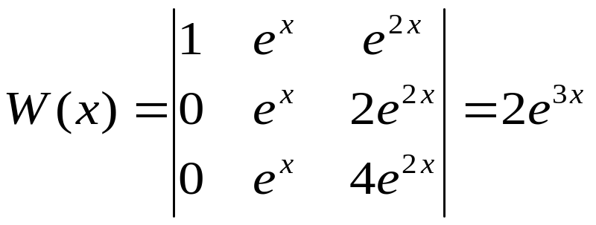
Linear Independence of Functions
Example: Linearly Independent Set in C²(-~,~)
Show that f₁=1, f₂=e^{x}, and f₃=e^{2x} form a linearly independent set of vectors in C²(-~,~).
This function does not have value zero for all x in the interval (-~,~), so f₁, f₂, and f₃ form a linearly independent set.

